Slide 1
Executive Summary
Arindam Samanta
DSC640-T302
Bellevue University

Slide 2
ABOUT US
At Contoso, we empower organizations to foster collaborative thinking to further drive workplace innovation. By closing the loop and leveraging agile frameworks, we help business grow organically and foster a consumer-first mindset.

Slide 3
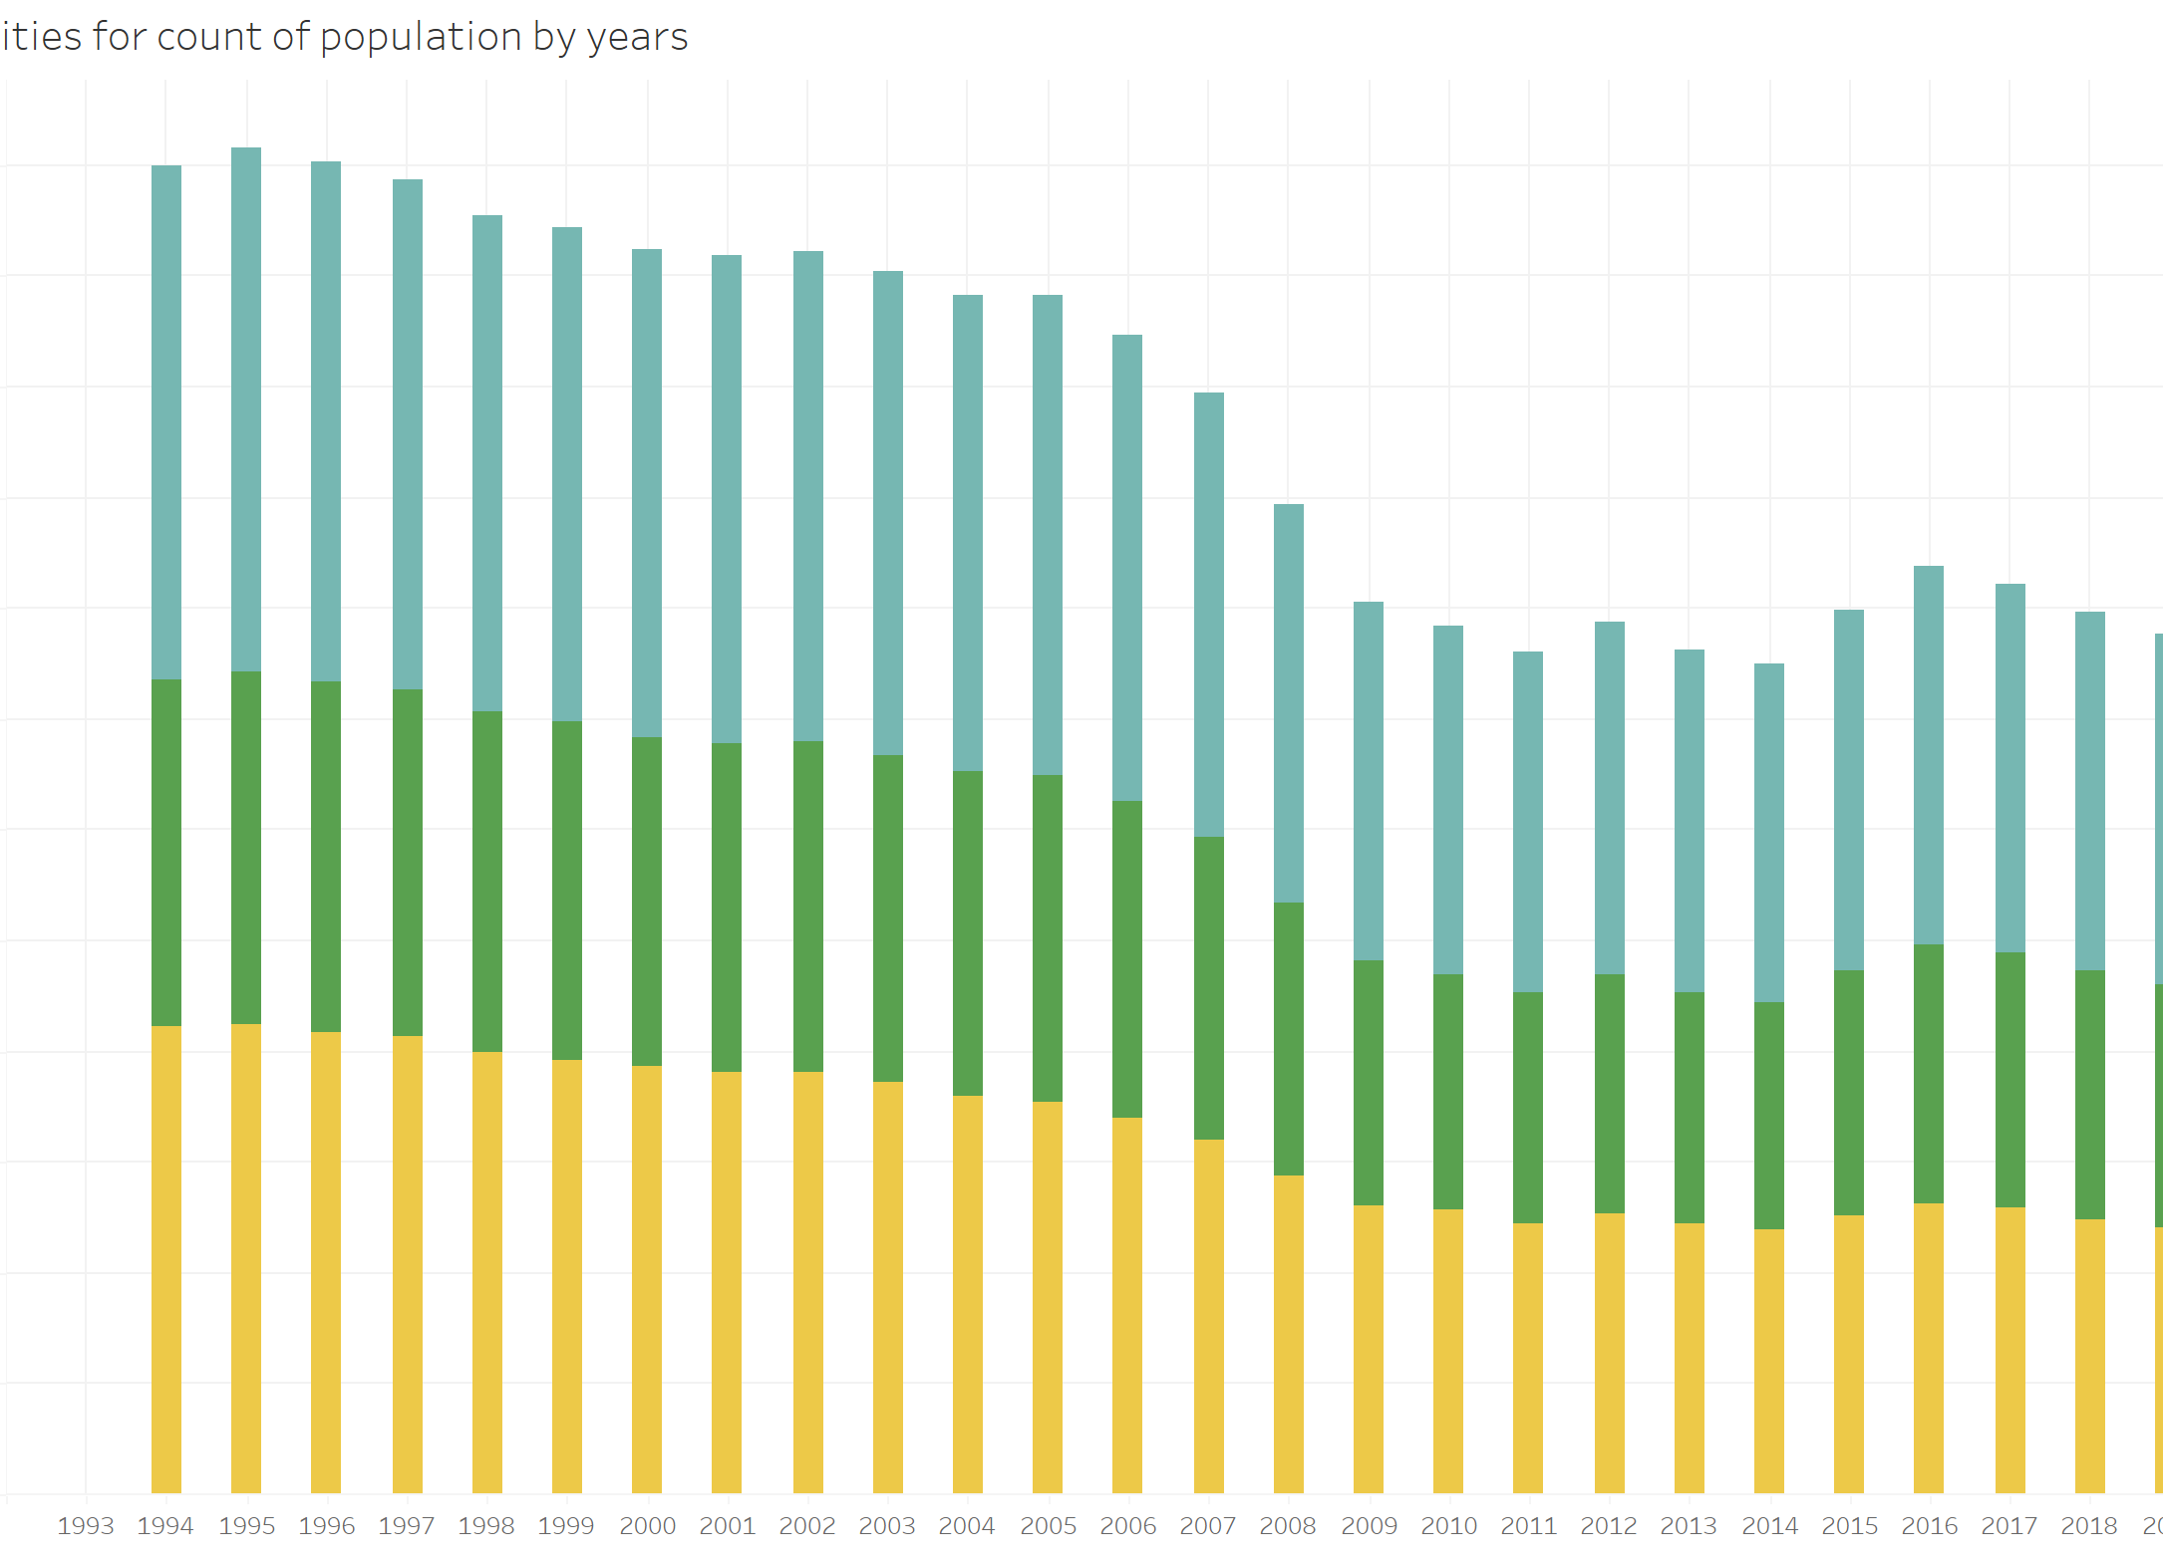
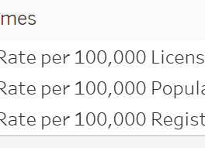

Slide 4
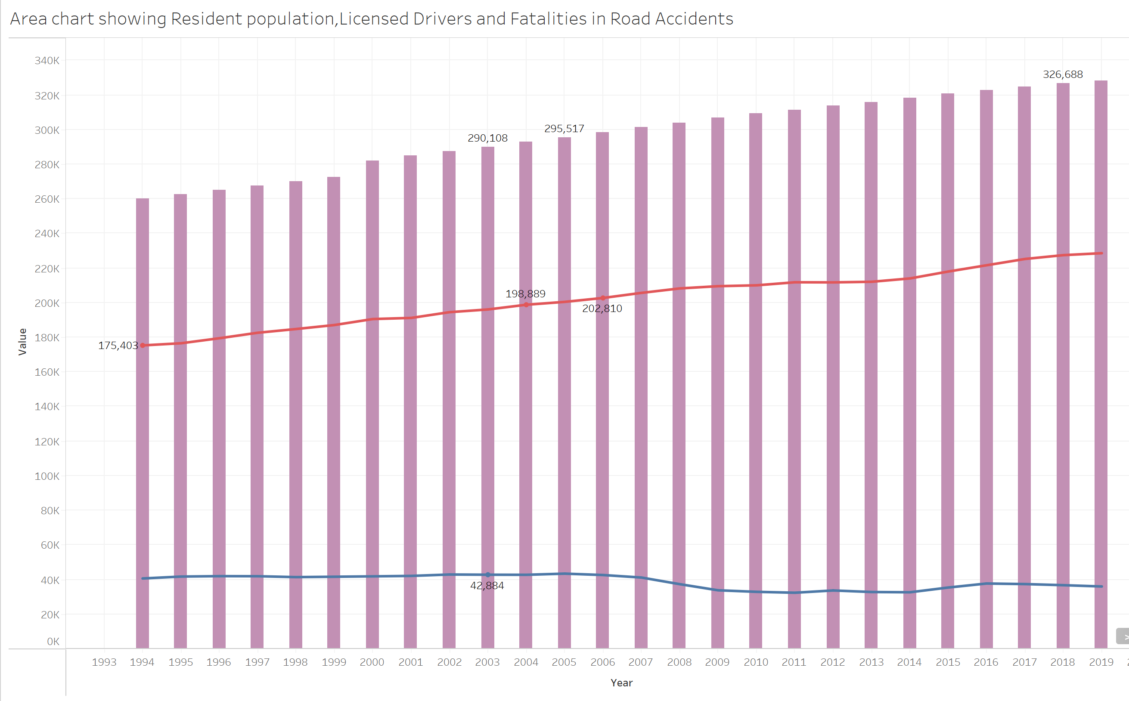

Slide 5
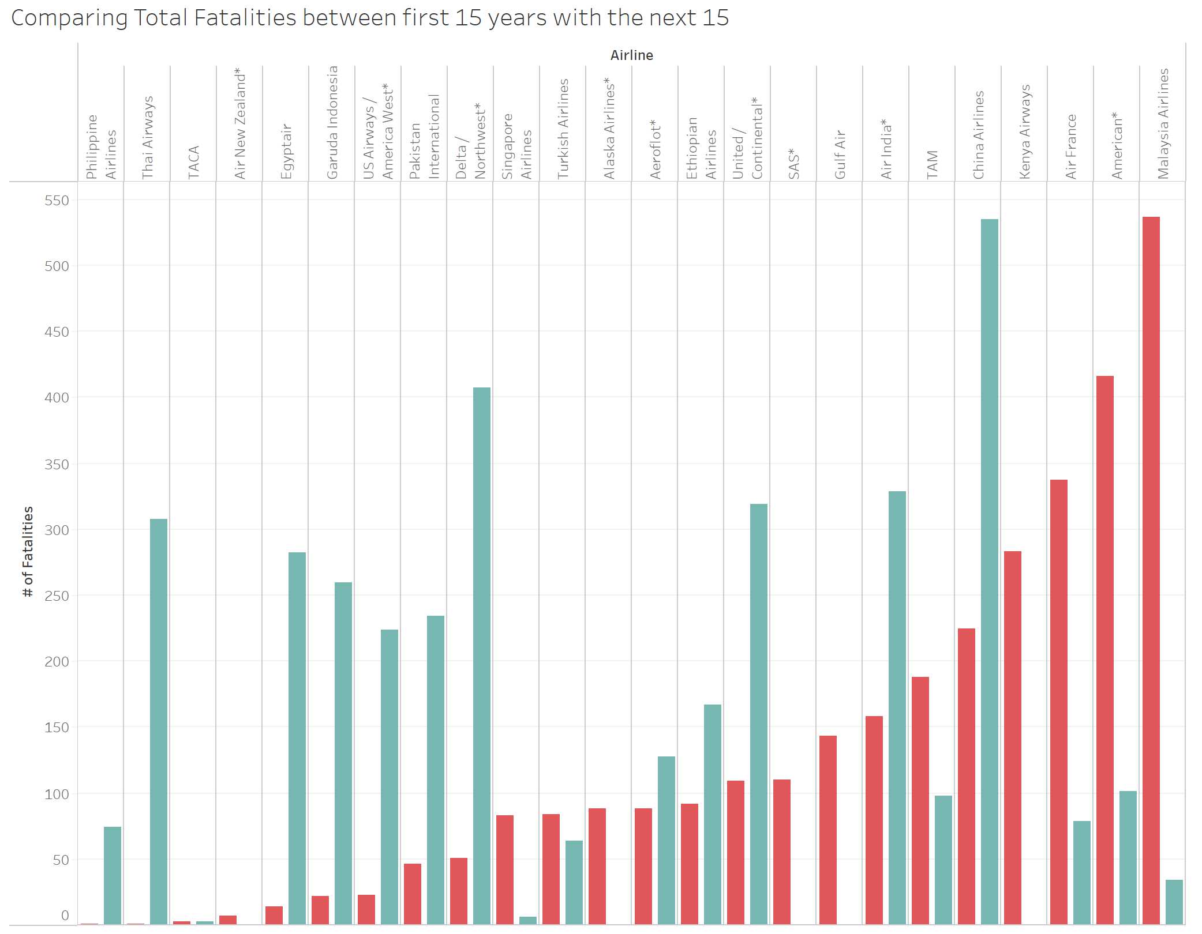

Slide 6
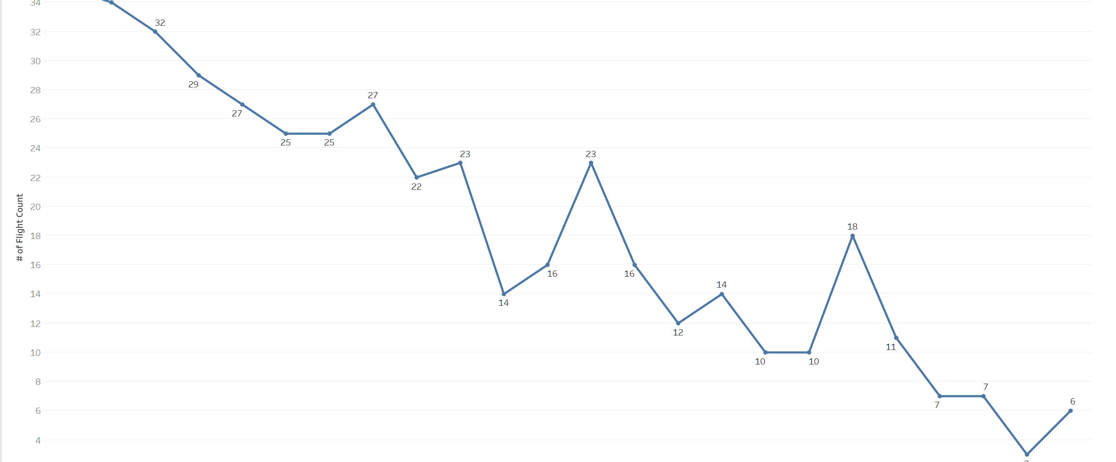

Slide 7
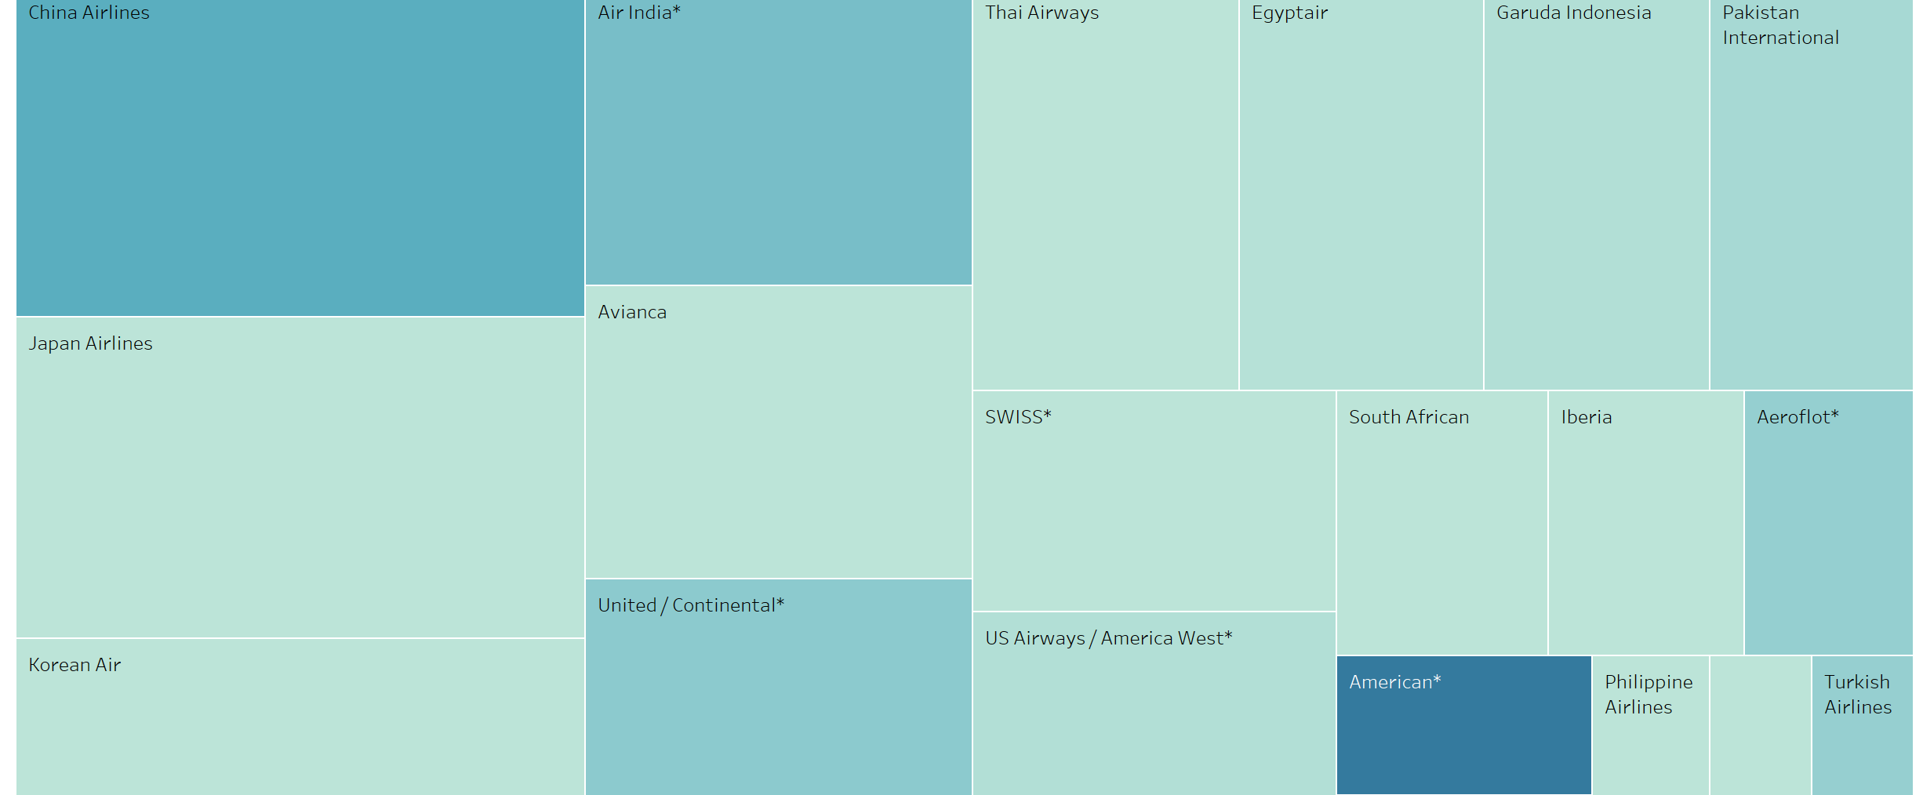

Slide 8
THANK YOU

